Slide 1

Capstone Project
Play Store App Review Analysis
By
Suraj kumar
Data Science Trainee, Alma Better

Slide 2
CONTENT
INTRODUCTION
PROBLEM STATEMENT
THE MOTIVE
DATASET PREPARATION
ATTRIBUTE IN GOOGLE PLAY STORE DATA
OVERVIEW OF ANALYSIS
CATEGORY WISE REVIEWS
AGE VS CONTENT RATING
CHALLENGES FACED
CONCLUSION

Slide 3
WHY ANALYZE THE GOOGLE PLAY STORE?
Android apps comprise 90% of the mobile app market.
Mobile app market is set to grow 20% by 2023.
What are some interesting patterns in user behavior related to app usage & feedback.
What makes an app popular? Can we predict how popular it’s going to be?

Slide 4
INTRODUCTION
The Google Play store launched on march 6th, 2012 consolidating the android market and other digital services, like Google Music and Google e Bookstore, into one offering. Currently storefront is available in over 190 countries and territories.
Google Play, formally known as android market, is the official distribution storefront for Android Applications and other digital media such as music, movies and books from google.
The purpose of our project is to gather and analyze details information on apps in the Google Play Store in order to provide insight on app features and the current state of the Android app market.

Slide 5
INTRODUCTION (continued)
Android is dominant mobile operating system today more than 85% of all mobile devices running Google’s OS. The Google Play Store is largest and most popular Android app store
There are more than 3.04 million apps found on Google Play Store

Slide 6
PROBLEM STATEMENT
Two data set are provided, one with basic information and the other with user reviews for the respective app.
We must examine and evaluate the data in both datasets in order to identify the important characteristics that influence app engagement and success.

Slide 7
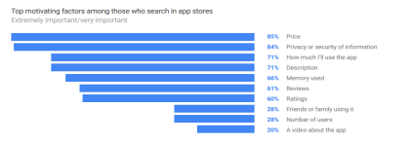
THE MOTIVE
Import Factors While Installing Apps: Play Store had widely network its get trouble for users to install the apps from play store.
Following are major roles for user while installing any apps from play store:

Slide 8
DATASET PREPARATION
Loading the data sets: Two data sets, first Play Store app dataset and user reviews datasets.
Importing libraries: NumPy, Pandas, Seaborn and Matplotlib.
Data cleaning: Null values, Finding and removing outliers, Removing duplicate data.
Data Manipulation: Filling the missing categorical values with mode and numerical values with median. Conversion of price installs, reviews into numerical values.
Exploratory Data Analysis: Analyzing the data sets to summarize their main characteristics using statistical graphics and data visualizations method

Slide 9
ATTRIBUTE IN GOOGLE PLAY STORE DATA
Apps: The apps name.
Category: Categorical label, which describes which broad category the app belongs to.
Rating: Continuous variable with a range 0.0 to 5.0, which describe average rating.
Reviews: Continuous variable describing the number of reviews that the app received.
Size: The size of the app. The suffix M is used for megabytes while K used for kilobytes.
Install: Categorical label that describes the number of installs.
Type: Label that indicates whether the app is free or paid.

Slide 10
ATTRIBUTE (continued)
Price: The price value for the paid apps.
Content Rating: Categorical rating that indicates age group for which app is suitable.
Genre: Semicolon-separated list of genre to which the app belongs.
Last Update: The date of the app was last updated.
Current Version: The current version of the app as specified by the developers.
Android Version: The Android operating system the app is compatible with.

Slide 11
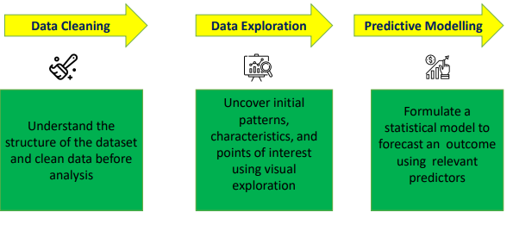
OVERVIEW OF ANALYSIS

Slide 12
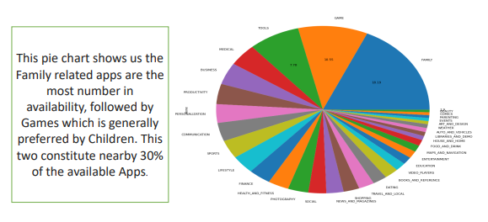
DISTRIBUTION OF CATEGORY

Slide 13
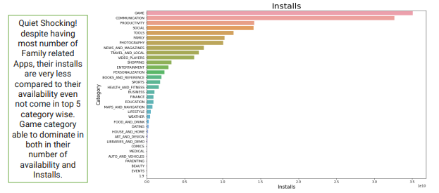
CATEGORY WISE INSTALL

Slide 14
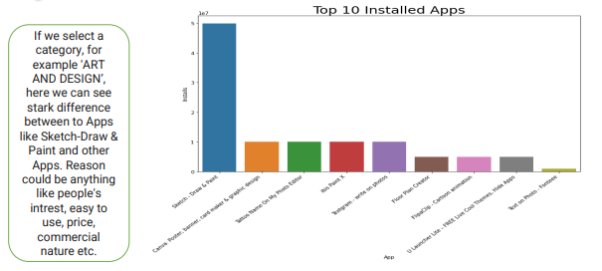
TOP 10 INSTALL APPS IN ANY CATEGORY

Slide 15
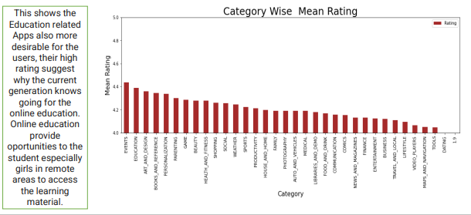
CATEGORY WISE MEAN RATING

Slide 16
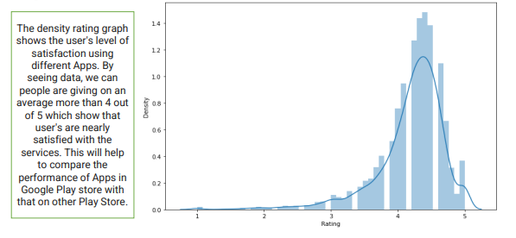
DENSITY OF RATING

Slide 17
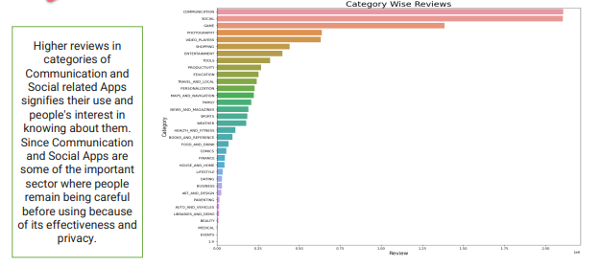
CATEGORY WISE REVIEWS

Slide 18
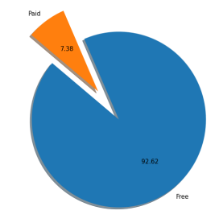
PERCENTAGE OF PAID APPS VS FREE APPS

Slide 19
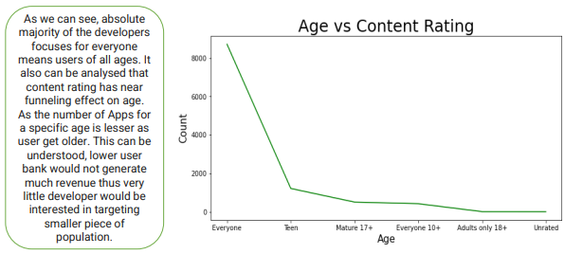
AGE VS CONTENT RATING

Slide 20
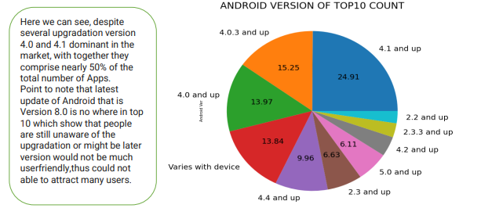
ANDROID VERSION OF TOP 10 COUNT

Slide 21
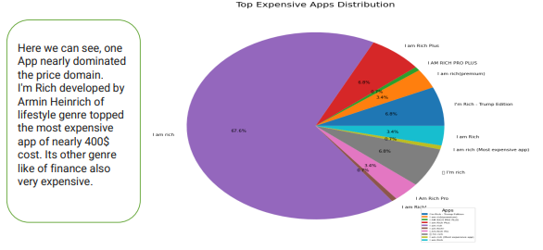
TOP MOST EXPENSIVE APPS

Slide 22
CHALLENGES FACED
The data has lot of chunk features everyone not be missing so handle with care to our dataset.
The Data must be clean, a single string can make our total data irrelevant for analysis.
User reviews and play store are of two types data which have to work simultaneously is considering a bit time consuming. Reading the dataset and comprehending the problem statement.
Examining the business KPIs for app development and devising a solution to the problem.

Slide 23
CHALLENGES FACED (continued)
Handling the error, duplicate and Nan values in the dataset.
Designing multiple visualizations to summarize the information in the dataset and successfully communicate the results and trends to the reader

Slide 24
CONCLUSION
Most of the Apps are compatible with Android Version of 4.0 and 4.1.
Version of 8.0 despite being latest, not comes even in top 10 in compatibility with other Apps.
I'm Rich developed by Armin Heinrich of lifestyle genre topped the most expensive app of nearly 400$ cost. Its other genre like of finance also very expensive.
By analysing heatmap, we can point out that Reviews and Installs are most closely related in a positive way.
Price relation with every feature is near zero because for most of the Apps price are free.

Slide 25
CONCLUSION (continued)
Communication and Social category of Apps got most number of reviews. Might be duty to the sensitivity of privacy which user see before using these Apps.
Nearly 93% of Apps are free thus make Android Market more popular store than others.
By looking at Category Wise Size, the most number of Category have average size in between 10MB and 20 MB. Games occupies the maximum amount of space up to 40 MB still have a maximum number of Installs.
Most of the Apps are suitable for Everyone, as we increase the suitable age less and less number of Apps are targeted.

Slide 26
THANK YOU

